Slide 1


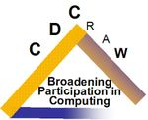
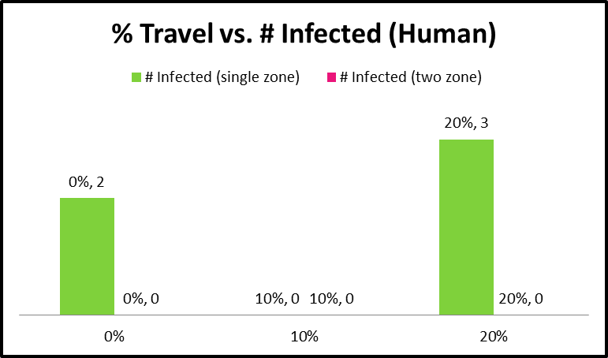
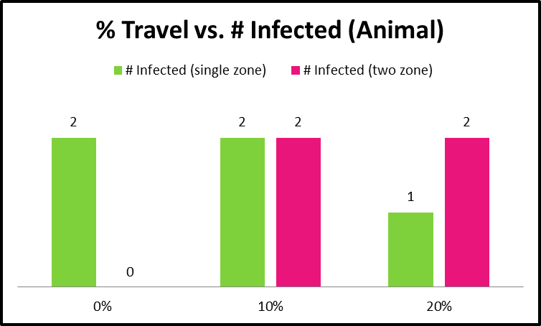
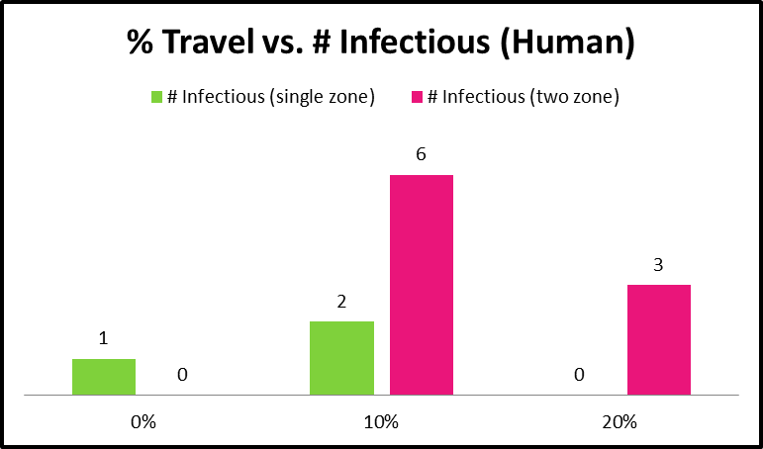
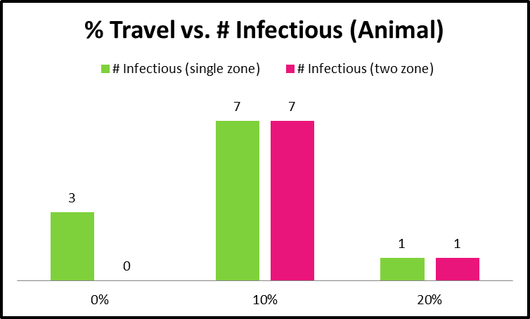
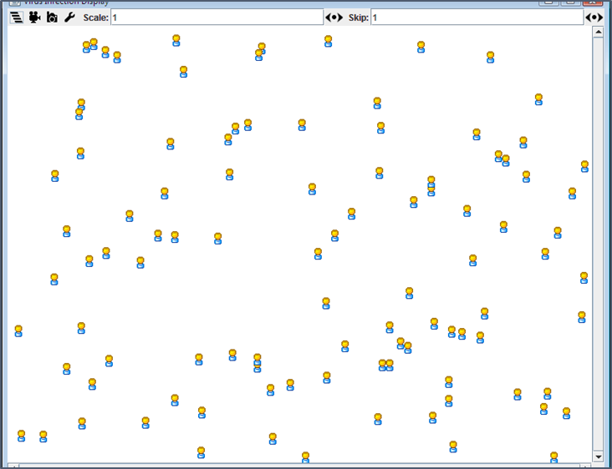
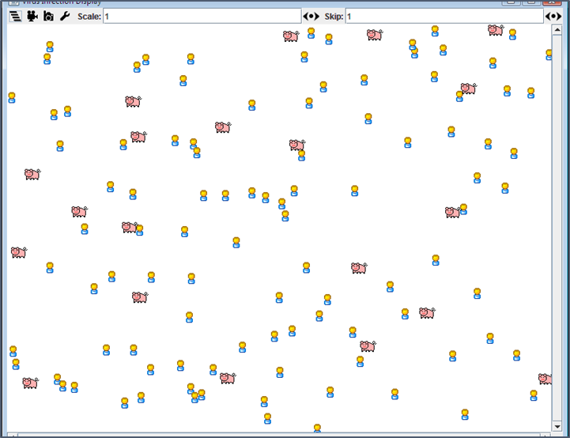
Emerging Infectious Diseases: A Computational Multi-agent Model
L. Patrice McGahee, Courtney Dill, Kiara Brown, Dr. Hong Qin
Biology Department
Introduction
results
Our simulation environment is defined through a database that contains all the information that is required to create the multi-agent simulation system including information about virus agent, host agent, and landscape of agents. Each agent and landscape has their attributes and functions. The agents follow the function to interact with each other and demonstrate group patterns.
Virus Agents bear characteristics such as “Infectious period”, “Latency period”, and “Virulence”. At the start of simulation, agents of virus should largely be located on non-human hosts, such as pets or birds with “virulence” characteristic. After association with a host agent, i.e. infection, the virus enters “Latency period”. The virus agent enters “Infectious period” after given “Latency period”. Each agent of virus has its DNA/RNA sequence, which can mutate when the virus transfer from host to host.
Host Agents can be human, birds, and pets. Human populations include individuals that are resistant and susceptible to virus infection. Human individuals in urban areas are more likely to travel long distances, whereas those in rural areas are less likely to travel. The states of the agent will be “susceptible”, “infected/incubation”, “infectious”, and “recovered/not recovered”.
A host agent is likely to be infected when it contacts another infectious agent with a certain exposure and infection rate. Upon infection, the agent is associated with a disease or virus and enters “incubation”, but at this stage it is unable to infect other agents.
After a given “latency period” of the virus, the agent becomes “infectious” and can infect other agents. Finally, after an “infectious period”, agents become “recovered” and they are immune against the disease or dead. A virus agent moves through association with a host agent that travels through transportation networks. The speed of the virus spread is related to the “lag” or “incubation” which is the duration a host agent is infected, although not yet showing symptoms. If the “lag” is long, patients are likely to travel longer and further and interact more often with other agents, which will give agents more chances to pass the viruses to more host agents in distant locations. If the “lag” is short, then viruses will grow faster in the host and have more potency for additional infection, but it is more likely to be limited to a local population. We will either simulate virus mutants to randomly adopt these two contrasting strategies, or allow mutants to follow a normal distribution of “lag”.
Table 1
Table 2
Hypothesis
The disease with stronger transmissibility in densely-populated areas will be transmitted to larger areas.
Table 3
Table 4
Materials & METHods
conclusion
Experiment 1:
Examine the effect of pathogen reservoirs and human populations
We will conduct simulation on variation of virus reservoirs. For an example of our hypothesis, SARS-CoV infected pets that tend to have close-contact with humans, whereas bird flu viruses infected chickens that tend to be isolated in farms in rural area. Therefore, SARS spread globally and infection of bird flu is limited. This difference is further amplified by the different traveling pattern of human populations: urban human populations are more likely to travel than rural human populations.
Experiment 2:
Examine the effect of transmission path
We will conduct a series of experiments on variation of transmission paths. Specifically, the infectious diseases can be transmitted from human-to-human and animal-to-human. For example, SARS viruses can be efficiently transferred from human-to-human, whereas bird-flu viruses are primarily transferred from bird-to-human..
Through our reading and preliminary experimentation, we discovered that among three strains of a common disease, the middle strain, (as far as virulence is concerned), would have the highest threshold. We see a similar pattern when studying and comparing the speeds of infection in relation to how much people/animals travel. In the cases of infectious agents, 10% travel yields more infectious agents, (in both single and two zone simulations). The numbers of those actually infected, however, is zero in human to human transmission. The number of people infected in animal to human transmission is 2, but in both cases, the single and two zone share the same number of infected agents. This only means that the infection
References
Auchincloss, AH and Diez Roux, AV (2008) A new tool for epidemiology: the usefulness of dynamicagent models in understanding place effects on health, Am J Epidemiol, 168, 1-8.
Riley, S (2007) Large-scale spatial-transmission models of infectious disease, Science, 316, 1298-1301.
Yang, Z (2006) Computational Molecular Evolution. Oxford University Press, Oxford.
Yergens, D, Hiner, J, Denzinger, J and Noseworthy, T (2006) Multi Agent Simulation System for Rapidly Developing Infectious Disease Models in Developing Countries, Proceedings of Autonomous Agents and Multiagent Systems (AAMAS), 104-116.
Acknowledgements
NSF CREU:
Hong Qin, Biology, Spelman College
Nagambal Shah, Mathematics, Spelman College
Li Yang, Computer Science, University of Tennessee at Chattanooga
Screen shot of simulation of Human-Human transmission
Screen shot of simulation of Animal -Human transmission

